Slide 1

NARASARAOPETA ENGINEERING COLLEGE
(AUTONOMOUS)
Text Summarization
Under the estimated guidance of
Sd. Rizwana, MTech, (Ph.D)
Presented By
P.Gayathri 19471A05N6
K. Dhana Lakshmi 19471A05K3
M.Nagasirisha 20475A0505

Slide 2
CONTENTS
Abstract
Introduction
System Requirements
Dataset
Existing System and it’s challenges
Proposed system
Modelling technique used and it’s advantages
UML Diagrams
Testing Screens
Output Screens
Conclusion

Slide 3
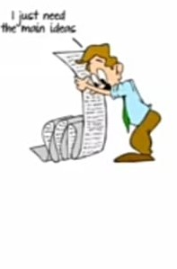
1. ABSTRACT
In this new era , where tremendous information is available on the internet , it is most important to provide the improved mechanism to extract the information quickly and most efficiently .
It is very difficult for human beings to manually extract the summary of a large documents of text.
There are plenty of text material available on the internet. So there is a problem
of searching for relevant documents from the number of documents available,
and absorbing relevant information from it.
In order to solve the above two problems, the automatic text summarization is
very much necessary.
Text summarization is the process of identifying the most important meaningful
information in a document or set of related documents and compressing them
into a shorter version preserving its overall meanings.

Slide 4
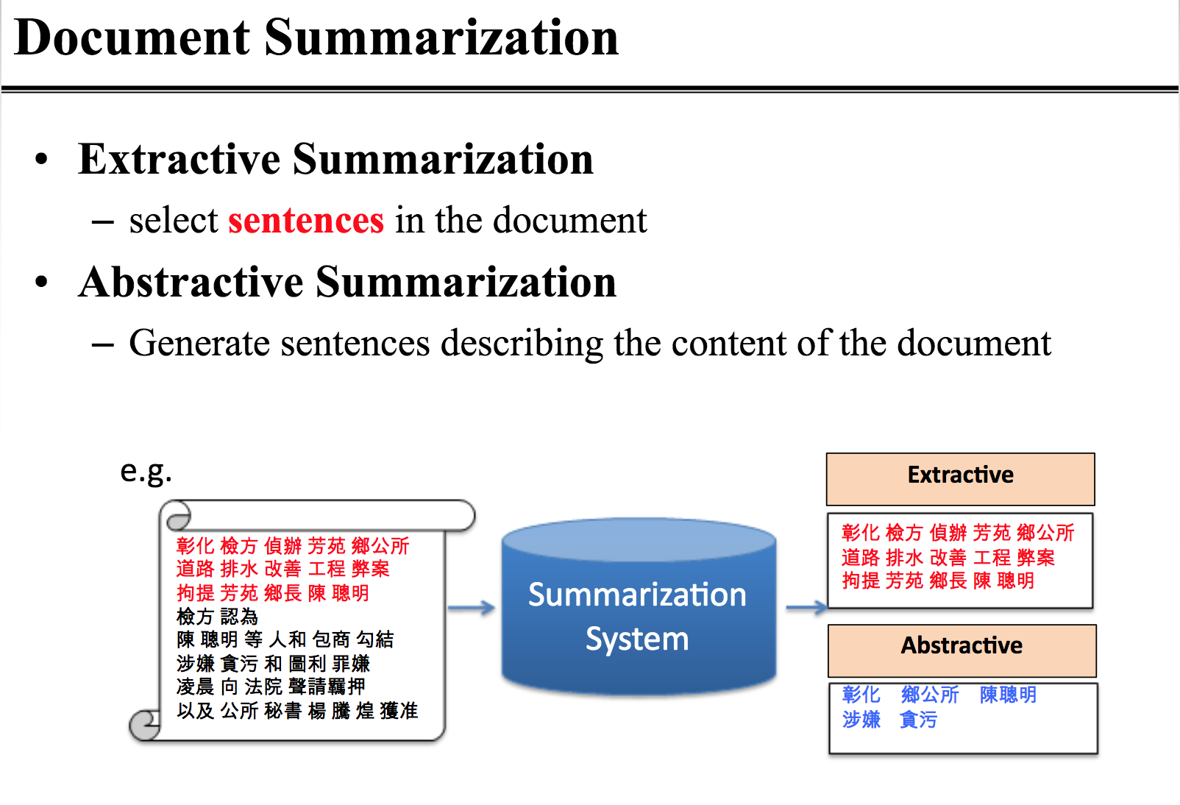
2.INTRODUCTION
Text summarization is the process of reducing the size of the original document while preserving its original information and the summary generated is less than half of the main text of the original document.
Summarization can be seen as a two-step process.
The first step is the extraction of vital concepts or sequence formation from the source text by building associate intermediate vector or file of sorts. This step may also include any pre-processing required to be done on the text including tokenization, tagging or otherwise.
The second step uses this intermediate file to generate a summary.
A summarization machine can be viewed as a system that accepts either a one document or multiple documents or a query as an input and can extract or abstract a summary based on that input.
Text Summarization is of two types:
Extractive Text Summarization
Abstractive Text Summarization

Slide 5
3.SYSTEM REQUIREMENTS
SOFTWARE REQUIREMENTS:
Operating system :windows 11, 64 bit OS
Coding language :Python
Python distribution :Anaconda, Flask, Jupyter Notebook
HARDWARE REQUIREMENTS:
System type : intel corei5
Cache memory : 4 MB
RAM : 12 GB
Hard Disc : 8 GB

Slide 6
5.EXISTING SYSTEM and IT’S CHALLENGES
EXISTING SYSTEM
In existing system does not focus on Advanced NLP Techniques. End user does not get reliable summaries.
In Existing system uses Extractive Text Summarization Technique Which does not give reliable summary.
In this paper, we focus on improving the existing system of the user.
CHALLENGES
Summary is less accurate.
Time constraint is less.
Computational speed is more.
It is uses extractive summarization.

Slide 7
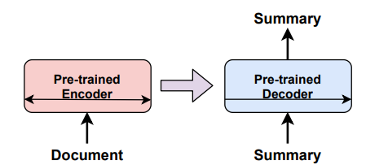
6 PROPOSED SYSTEM FLOW CHART
PROPOSED SYSTEM
In the proposed system mainly focuses on providing a reliable summary.
In the proposed system we are using Abstractive Text Summarization Which will provide the reliable summary. BART model is used.
Advantages:
Time Constraint is less.
Computational Speed is more.
Accurate Summary.
It uses Abstractive Summarization.
FLOW CHART

Slide 8
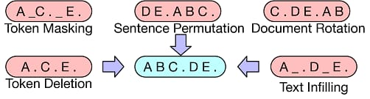
6.1 Pre-Training Techniques
Token Masking: A random subset of the input is replaced with [MASK] token. In this, sensitive information is replaced by random char in the same origin.
Sentence Permutation: The input is split based on periods such as “. , “ and then sentences are shuffled.
Document Rotation: A token is choosen at random and document is rotated about that token so that document begins with that token.
Token Deletion: Random tokens are deleted and the model add new token.
Text Infilling: A no.of /groups of tokens are drawn and each token is replaced by a masked token.

Slide 9
MODELLING TECHNIQUE and IT’S ADVANTAGES
The Model used to perform the abstractive text summarization is BART Model .
BART- Bidirectional & Auto Regression Transformer.
The BART model is a generalized pre-training model based on the Transformer model.
The BART model captures the words and sentences which are present in our document or text. And performs the five pre-training techniques.
ADVANTAGES:
Translating text from one language to another
Producing answers for a given question on a specific corpus
Giving a summary of or paraphrasing a long text document
Categorizing input text sentences or tokens
Evaluates the sentences are logical extensions or are logically related to a given statement.

Slide 10
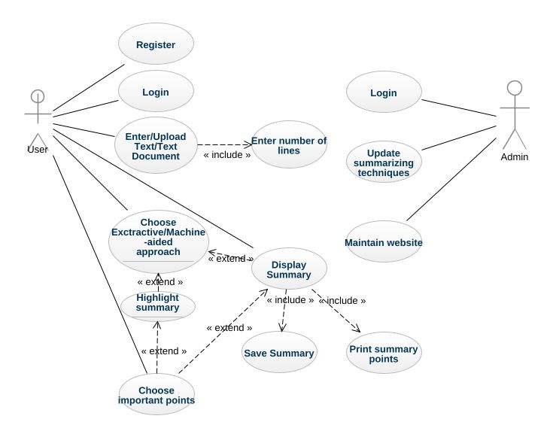
UML DIAGRAM

Slide 11
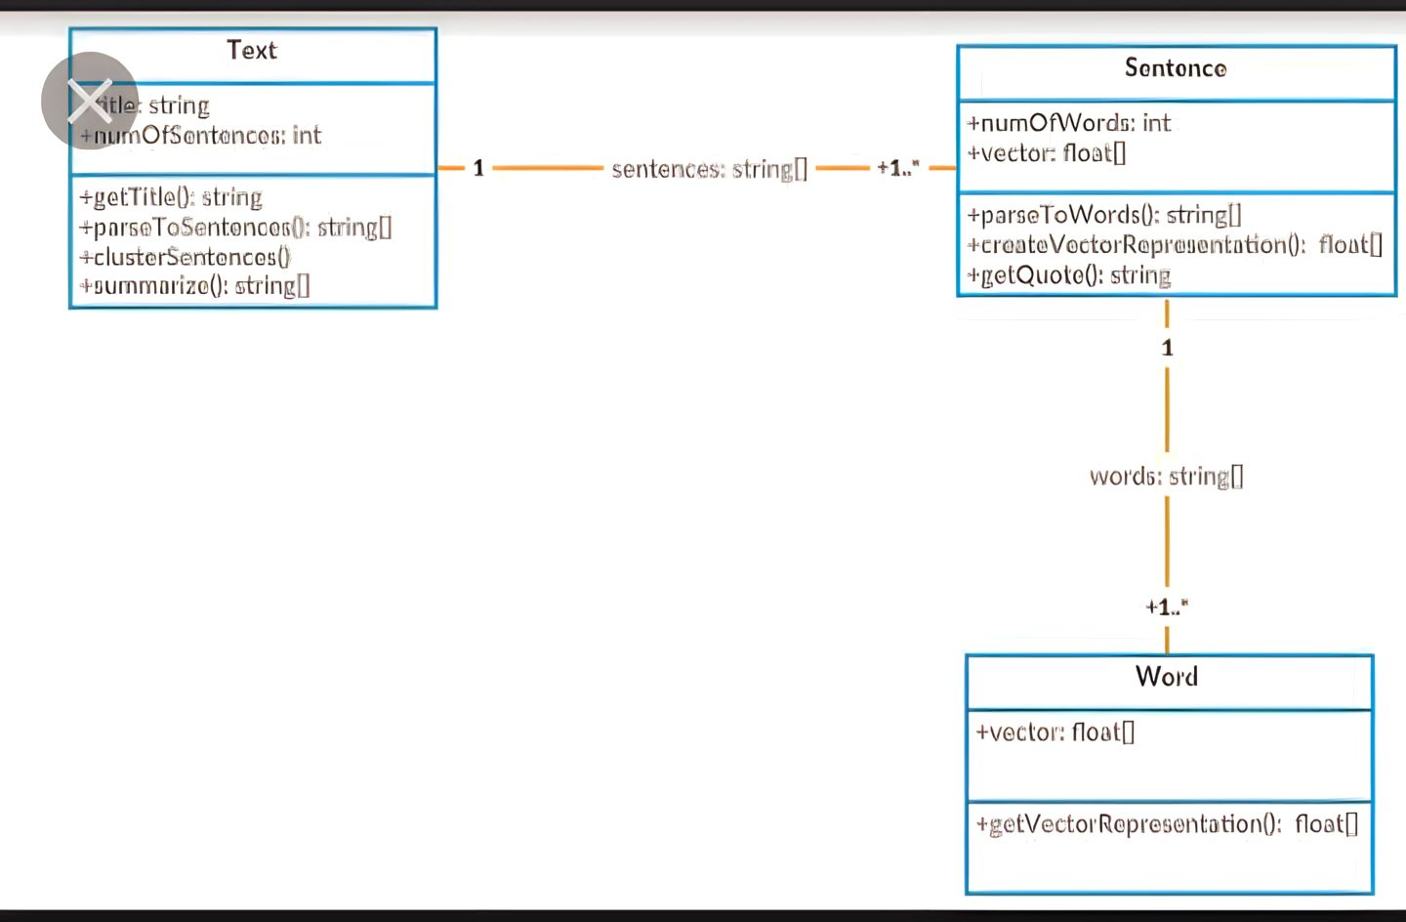
CLASS DIAGRAM

Slide 12
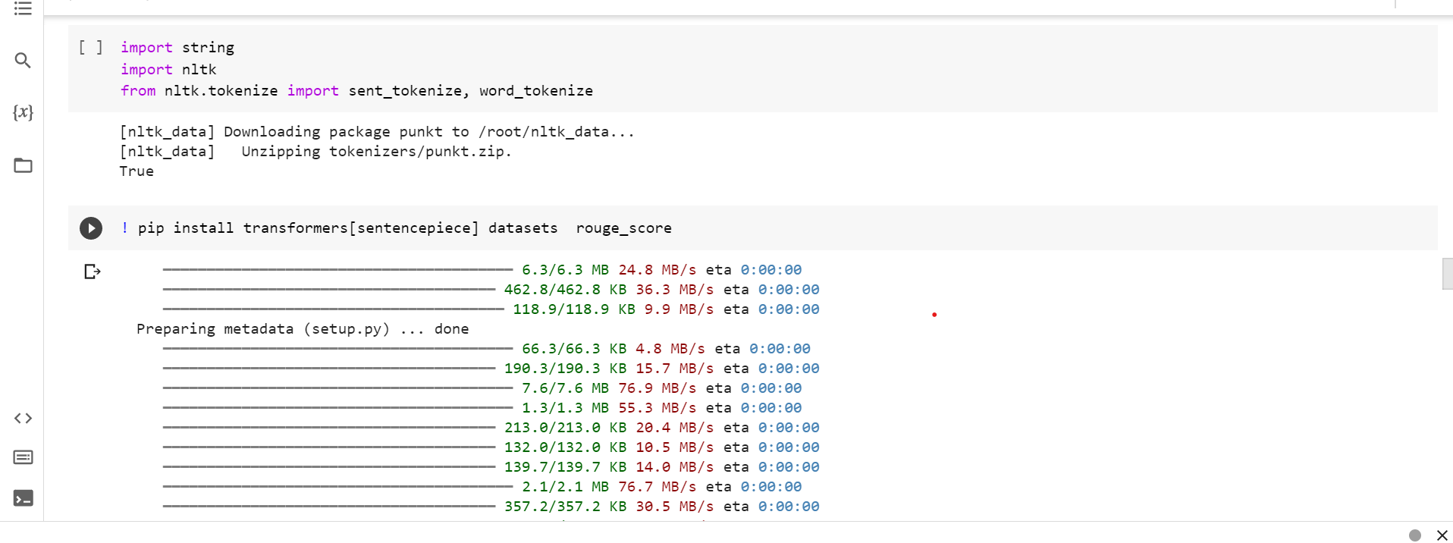
IMPLEMENTATION

Slide 13
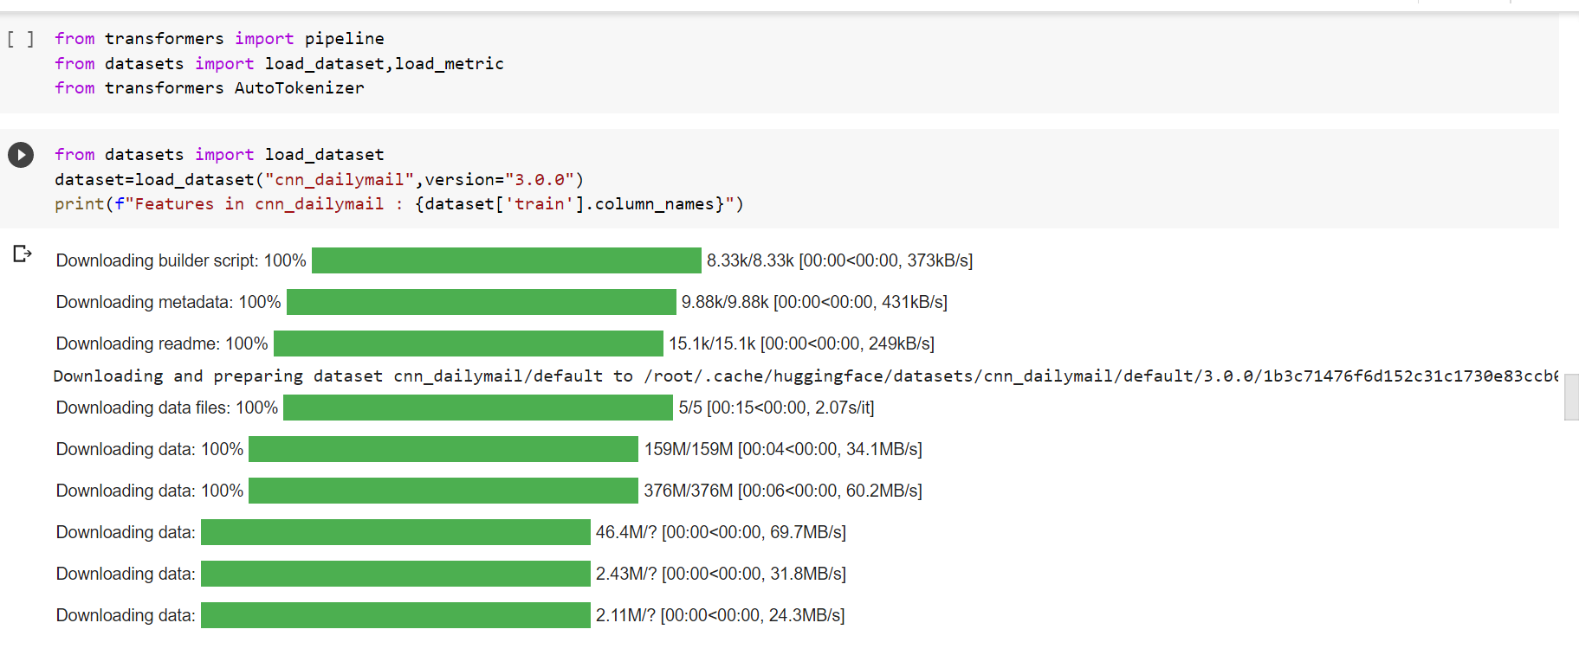

Slide 14
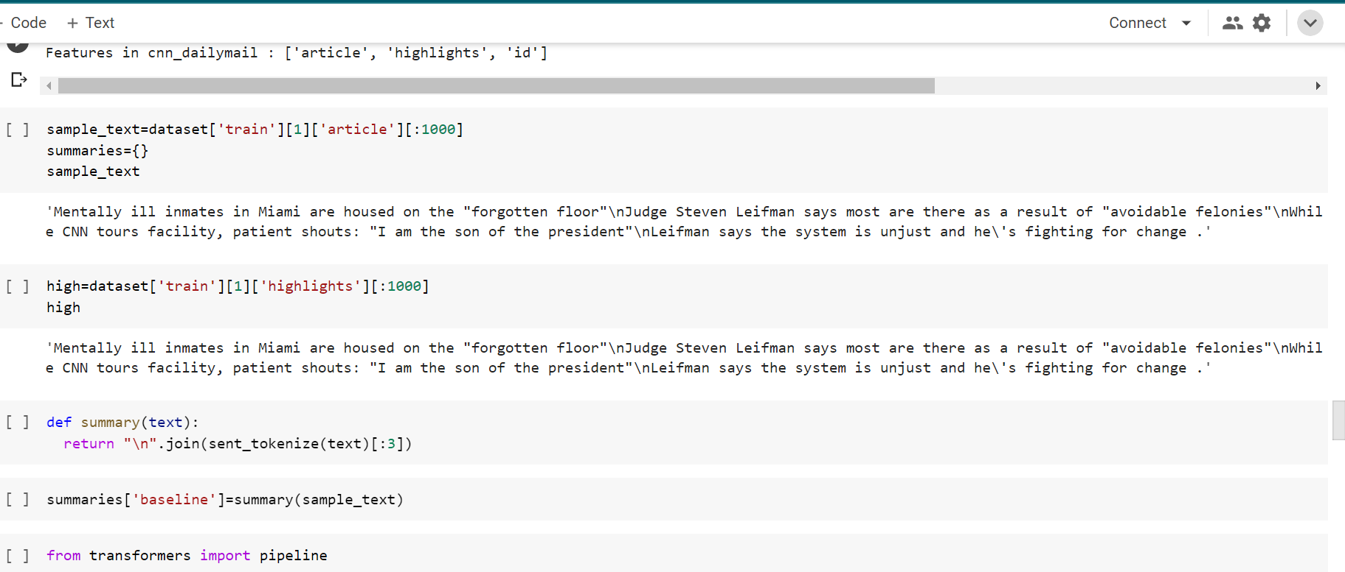

Slide 15
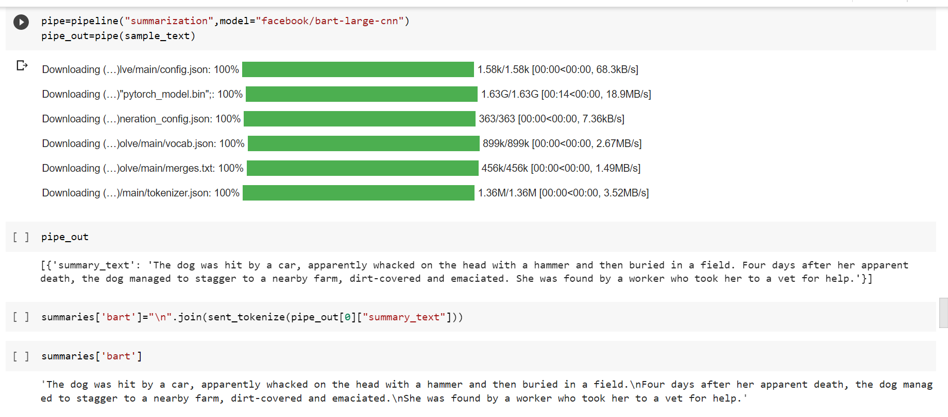

Slide 16
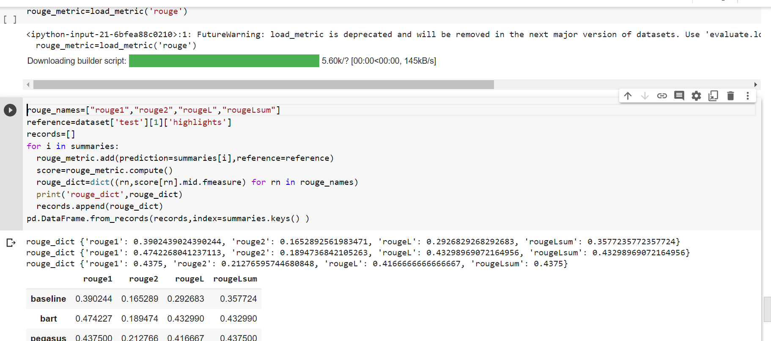

Slide 17
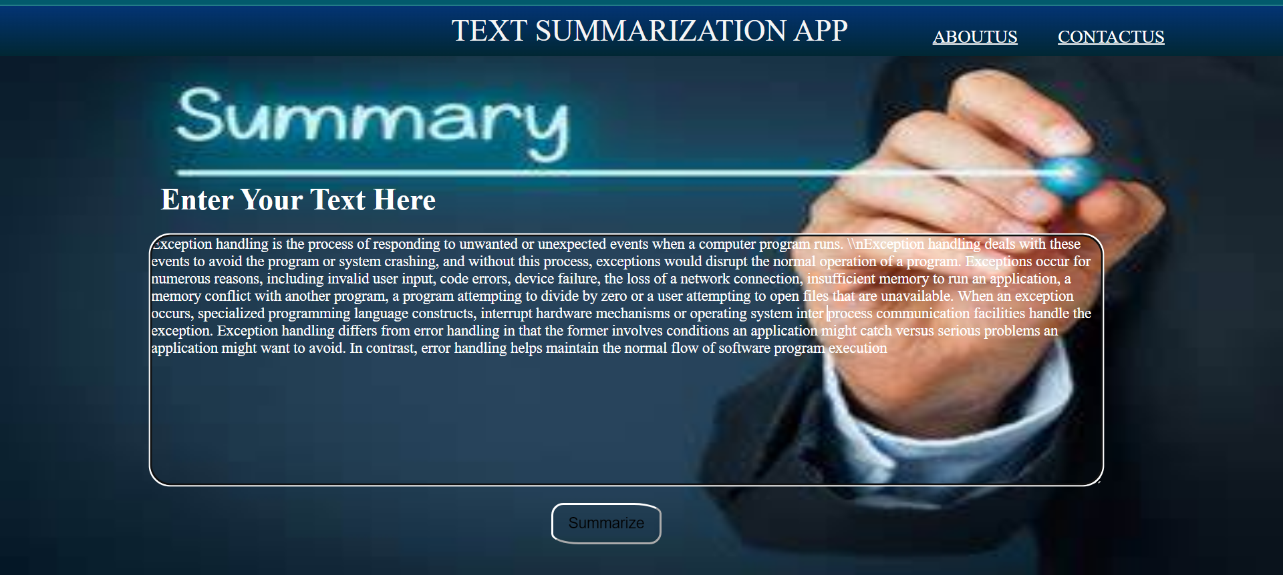
OUTPUT SCREENS

Slide 18
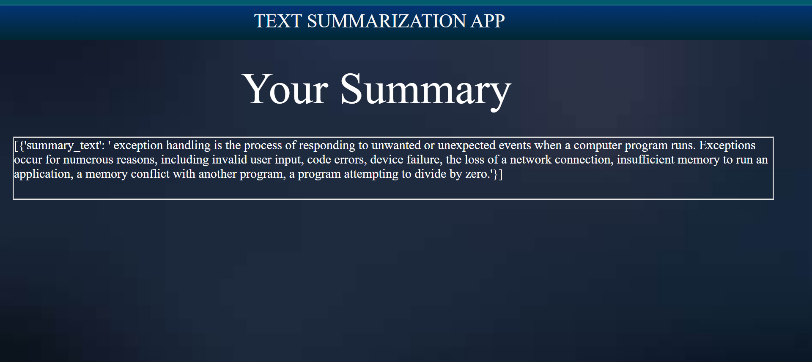
Summary Generated Page

Slide 19
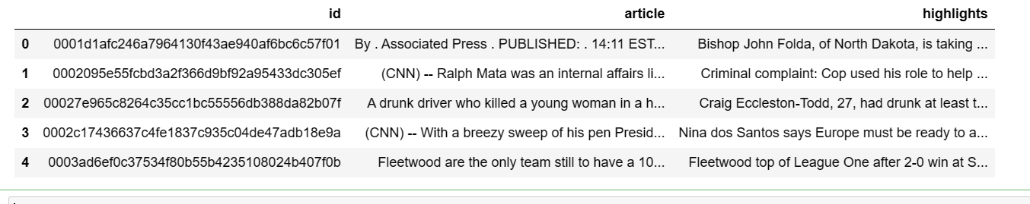
4.DATASET
https://www.kaggle.com/datasets/gowrishankarp/newspaper-text-summarization-cnn-dailymail
The dataset contains 3 attributes which are used to generate the summary of large article using BART model:
Article_id
Article
Highlights
Article_id: Holds the numerical data which carries the serial unique id’s for all the articles present in the dataset.
Article: Article attribute contains the large document or article which we need to summarize.
Highlights: The Highlights attribute contains the summary which is generated by the ml model which is further used as a reference for checking the accuracy of our summary.

Slide 20
CONCLUSION
In this study, we proposed Hie-BART to can take into account the relationship between words and sentences in BART by dividing the self-attention layer of encoder into word and sentence levels.
In the experiments, we confirmed that HieBART improved the F-score of ROUGE-L by 0.23 points relative to the non-hierarchical BART model, and the proposed model was better than the strong baselines, BERTSUM and T5 models for the CNN/Daily Mail dataset.
As future work, we intend to investigate methods to incorporate information between sentences in addition to word-to-word and word-to-sentence information.

Slide 21
ThankYOu

